Slide 1
Intro to Cryptography for CTFs and life.
Cryptology
(and other.)
by Cyrus Jian Bonyadi @pleoxconfusa
Notes:
Hi Cyrus I think this looks really great keep up the good work :)

Slide 2
What I’m Covering
Introduction
Cryptology, Mathematics
Ancient Cryptology
Encodings, Ciphers, Steganography
Modern Cryptology
Hashes, Message Authentication, Encryption, Key Exchange
Applications
Common
Uncommon
Rare
Mythic
CTF Challenges
National Suicide Prevention Lifeline
1-800-273-8255

Slide 3
What I’m Not Covering
Coding Theory
Finite Field Theory
Algebraic Topology
Where babies come from
Why your mother may or may not love you
How to make money by investing early in Burke Defense Solutions & Management
National Suicide Prevention Lifeline
1-800-273-8255

Slide 4
Introduction

Slide 5


Cryptology
The study of both:
Cryptography
The art of writing or solving codes
Focuses on integrity and confidentiality.
Cryptanalysis
The analysis of codes

Slide 6
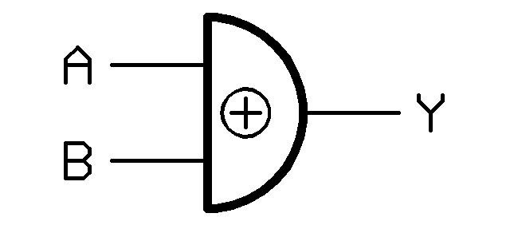
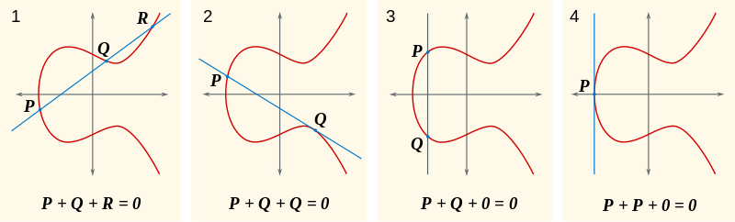
Required background mathematics terms
Addition
XOR
Exponents
Modulus
Pseudorandom Number
Pseudorandom Function
Pseudorandom Generator
P(x)
Pk(x)
P(k,x)
P

Slide 7
Ancient Cryptology

Slide 8
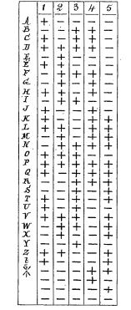
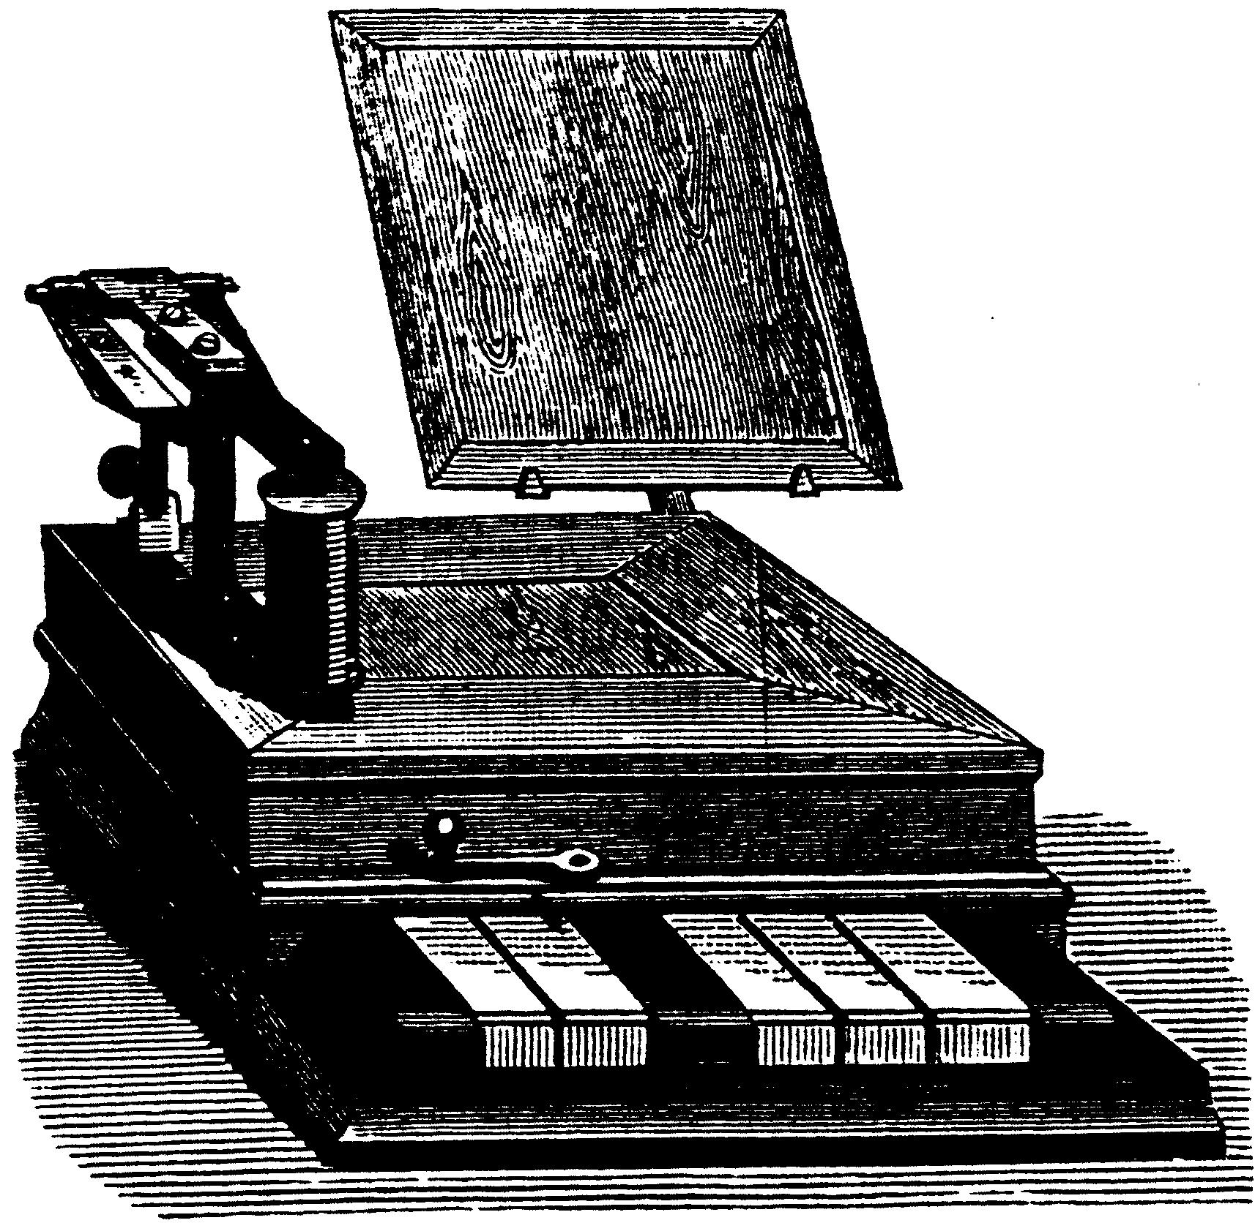
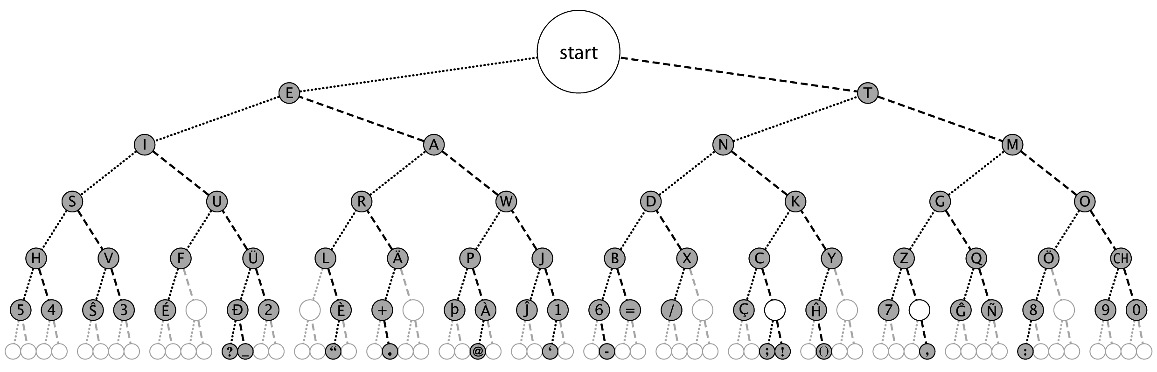
Encodings
Purpose:
Transport data
Methods:
Coding Theory
Example:
Morse
Baudot

Slide 9

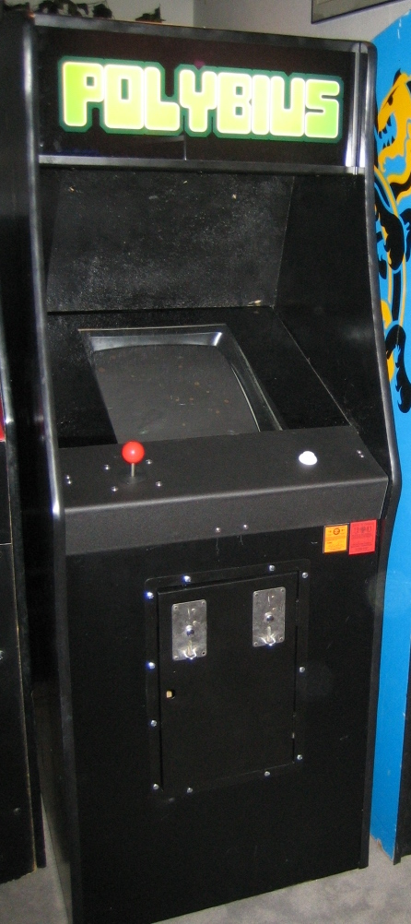
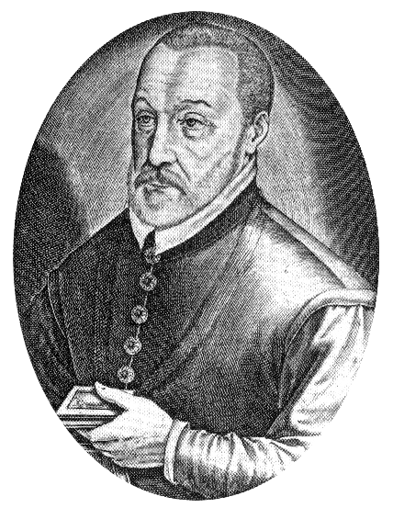
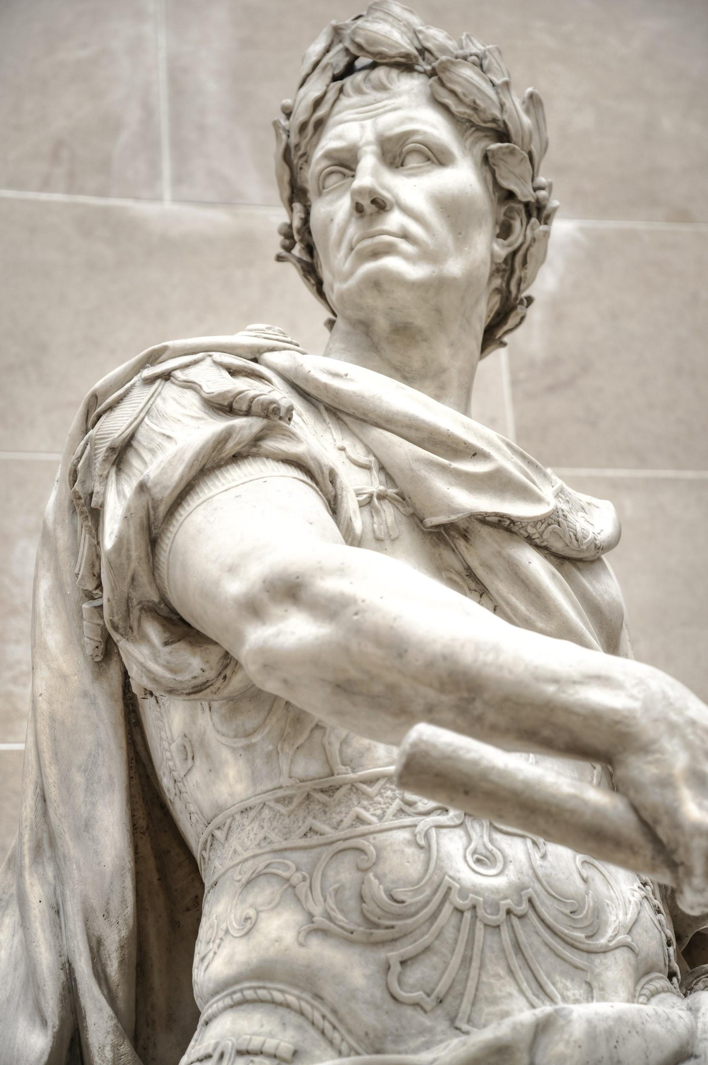
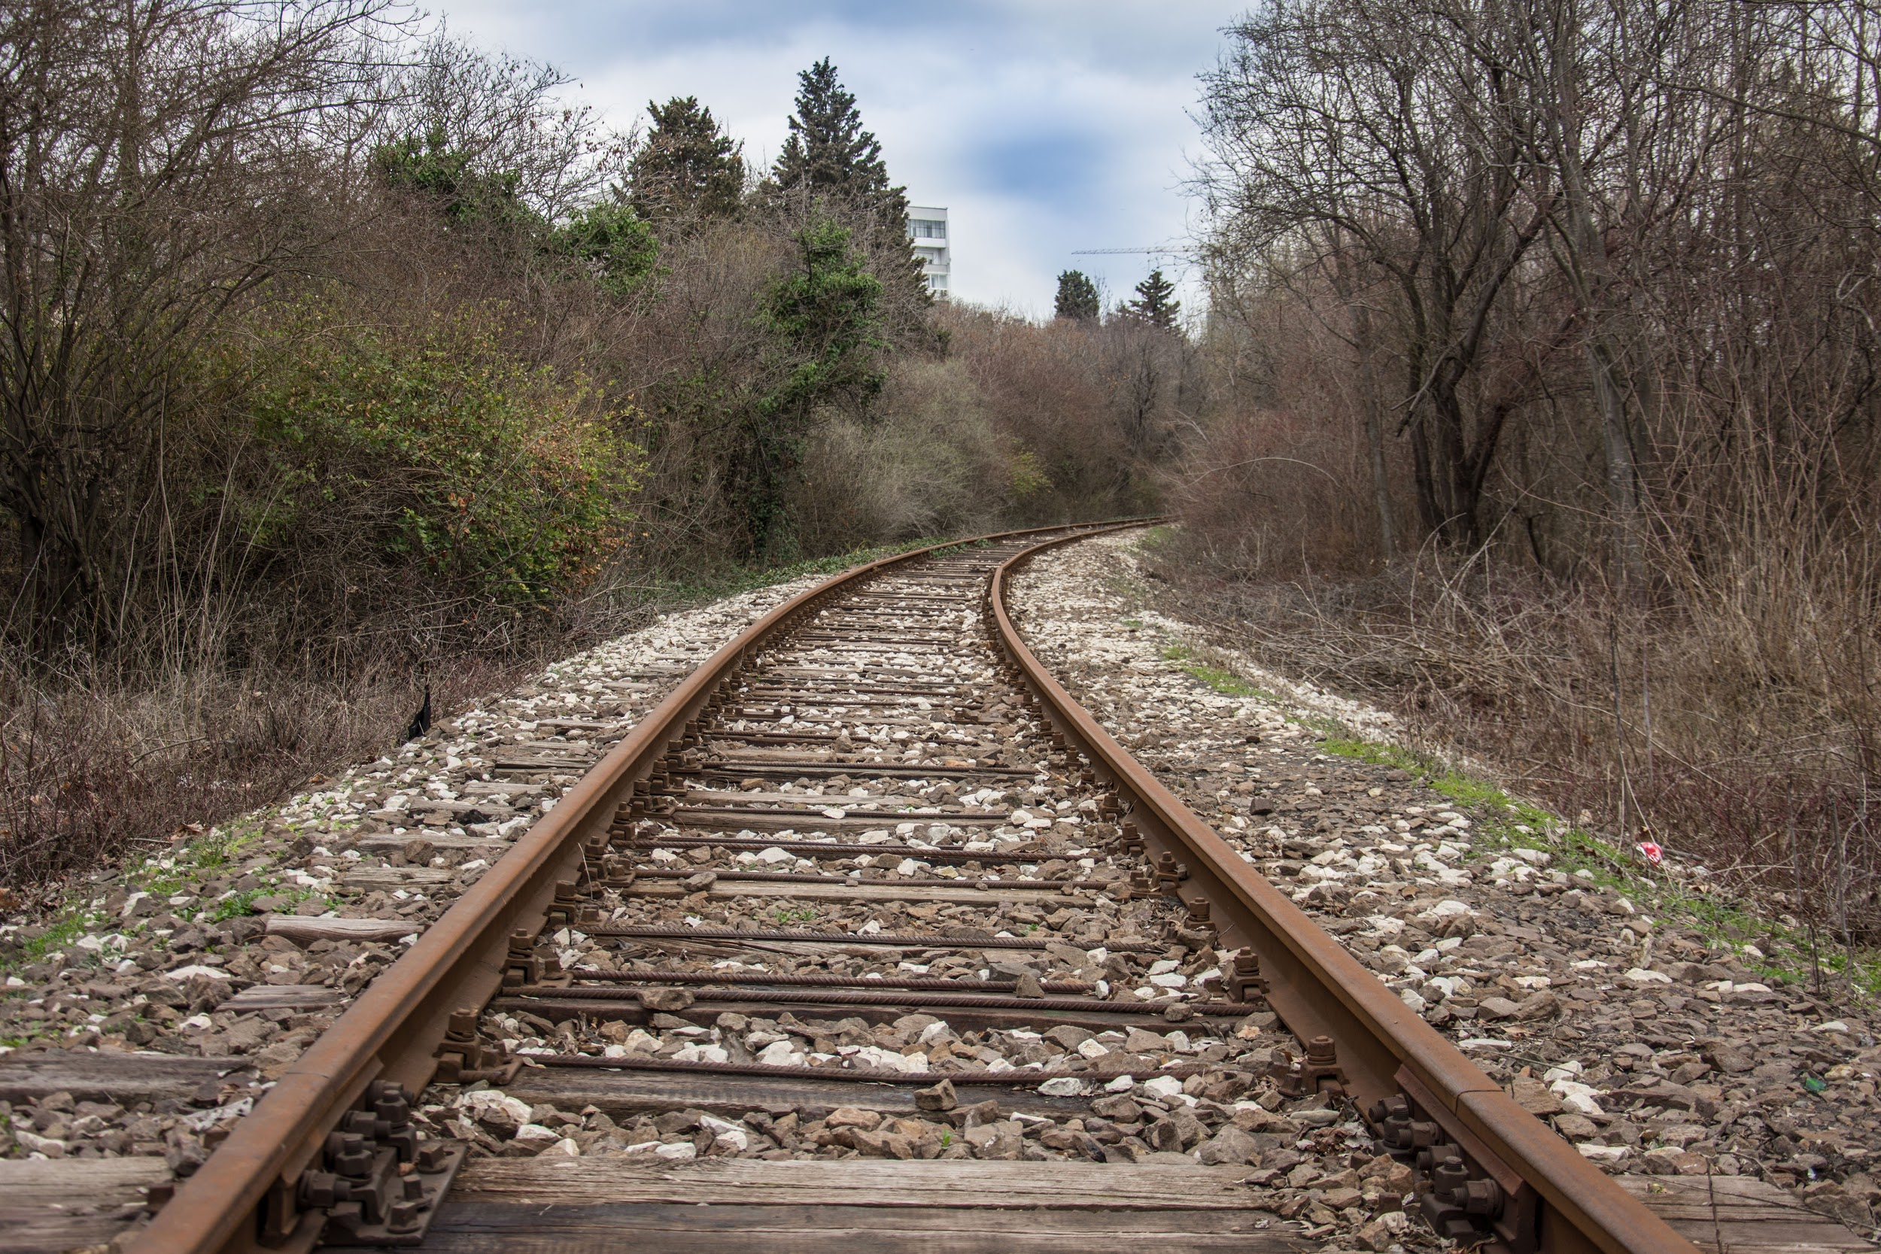
Ciphers
Purpose:
Hide content of data
Methods:
Rotational
Substitution
Weakness:
Frequency Analysis
Key Restrictions
Example:
ROT13
Websites:
dcode.fr, cyberchef.io

Slide 10
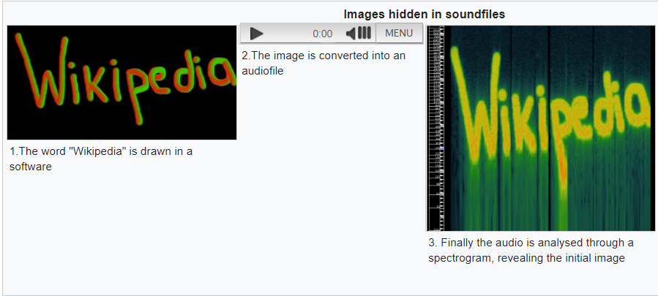
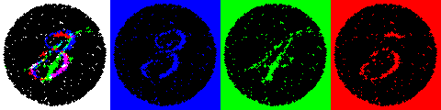
Steganography
Purpose:
Hide existence of data
Methods:
Data Mutability
Least/Most Significant
Others?
Weakness:
Not actually secured
Tools:
StegHide
OpenStego

Slide 11
Modern Cryptology

Slide 12
Hashes
Purpose:
Represent larger data in smaller form
Options:
Fuzzy
Keyed
Salted
Weaknesses:
Collisions
Methods:
Pseudorandom functions
Examples:
SHA
MD
LZJD

Slide 13
Message Authentication Codes (MAC)
Digital Signatures (DS)
Purpose:
Sign messages with a shared key
Tools:
Hashes
Symmetric Keys
Examples:
HMAC
CMAC
Functions:
Generate
Sign
Verify
Purpose:
Sign messages with a private key
Guarantee Non-repudiation
Tools:
Modular Arithmetic and ECC
Asymmetric Keys
Examples:
RSA/DSA
El Gamal
Functions:
Generate
Sign
Verify

Slide 14
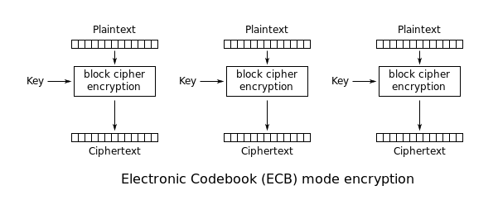
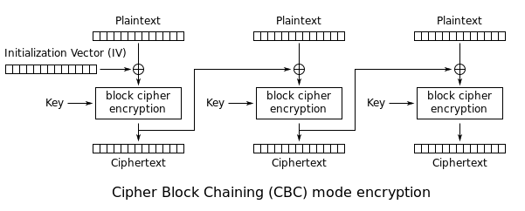
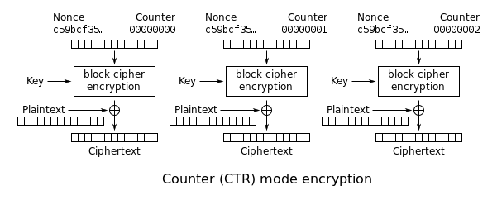
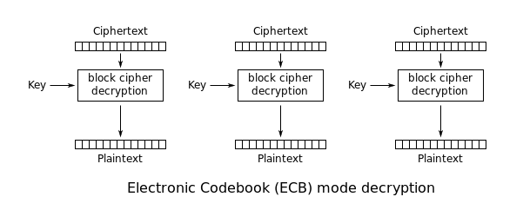
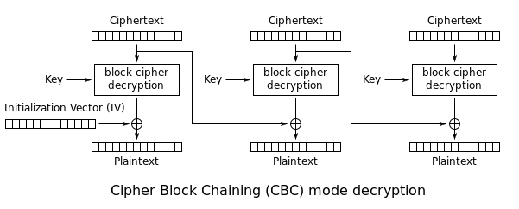
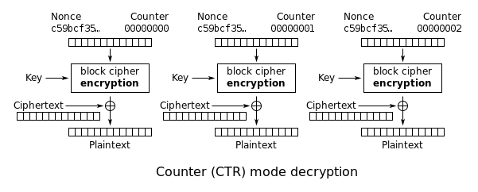
Advanced Encryption Standard (AES)
Purpose:
a specification for the encryption of electronic data with shared keys
Types:

Slide 15
Rivest, Shamir, Adleman (RSA)
Purpose:
Public key encryption and decryption.
Creation (stolen from wikipedia):
Choose two distinct prime numbers p and q.
Compute n = pq.
Compute λ(n), where λ is Carmichael's totient function. Since n = pq, λ(n) = lcm(λ(p),λ(q)), and since p and q are prime, λ(p) = φ(p) = p − 1 and likewise λ(q) = q − 1. Hence λ(n) = lcm(p − 1, q − 1).
Choose an integer e such that 1 < e < λ(n) and gcd(e, λ(n)) = 1; that is, e and λ(n) are coprime.
e is released as part of the public key.
Determine d as d ≡ e−1 (mod λ(n)); that is, d is the modular multiplicative inverse of e modulo λ(n).
d is kept secret as the private key exponent.

Slide 16
Rivest, Shamir, Adleman (RSA) (cont.)
Use (also stolen from wikipedia):
Encryption:
Decryption:
Total:
Total, reverse:
Any problems?
so many - anna

Slide 17
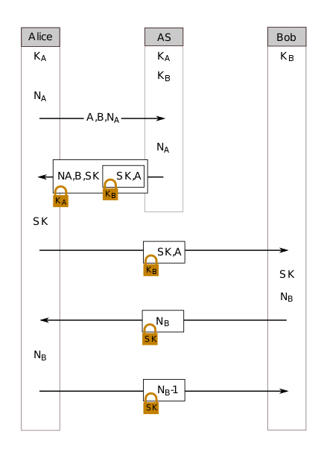
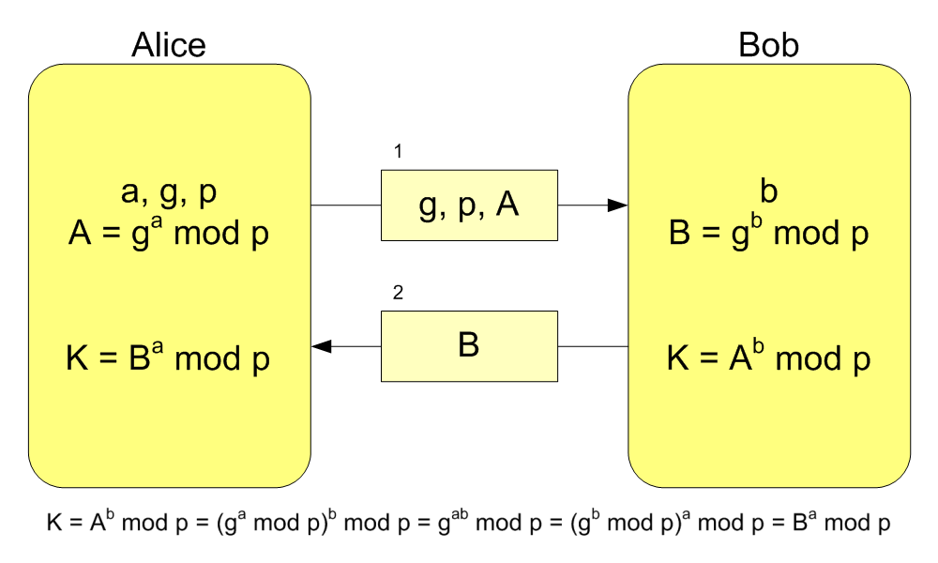
Key Exchange
Diffie-Hellman
Needham-Schroeder
Needham-Schroeder-Lowe

Slide 18
Common Challenges

Slide 19
Stego
Types
Spectrogram
LSB
MSB
Tools
StegHide
OpenStego
StegoVeritas
That’s it.
There’s nothing else I want to talk about.
Oh, you have a question?
No, go away.

Slide 20

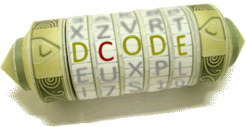
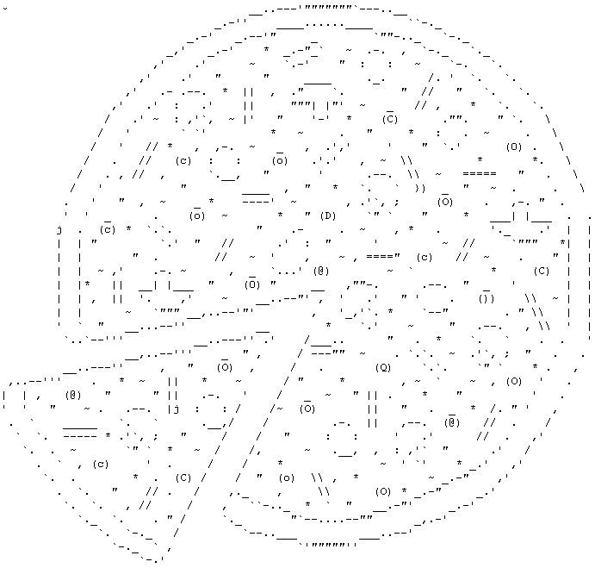
Cipher
Usual Suspects:
ROT13
Vigenere
Rail-fence
Pigpen
Atbash
Tools:
dcode.fr
cyberchef.io
Examples:
I’m not going to give an example. We did this on an earlier slide. Unless this lesson deviated from my original plan. In that case, ignore this bullet point, because here comes an example!

Slide 21
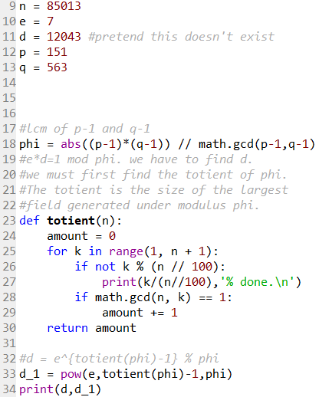
Low-n RSA
Characterized by:
n being pretty low (a visible number of digits)
c being a ciphertext, sometimes with commas
e being found and nothing else
The issue:
We do not have d
Solution:
factorize <n>
Get phi from p and q
Get d from e and modular inverse function
Decrypt to get m
Frequency:
Pretty freaking high.

Slide 22
Uncommon Challenges

Slide 23
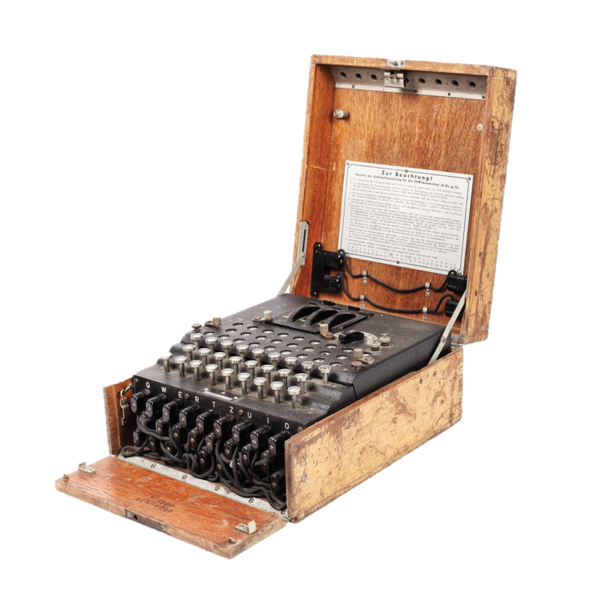
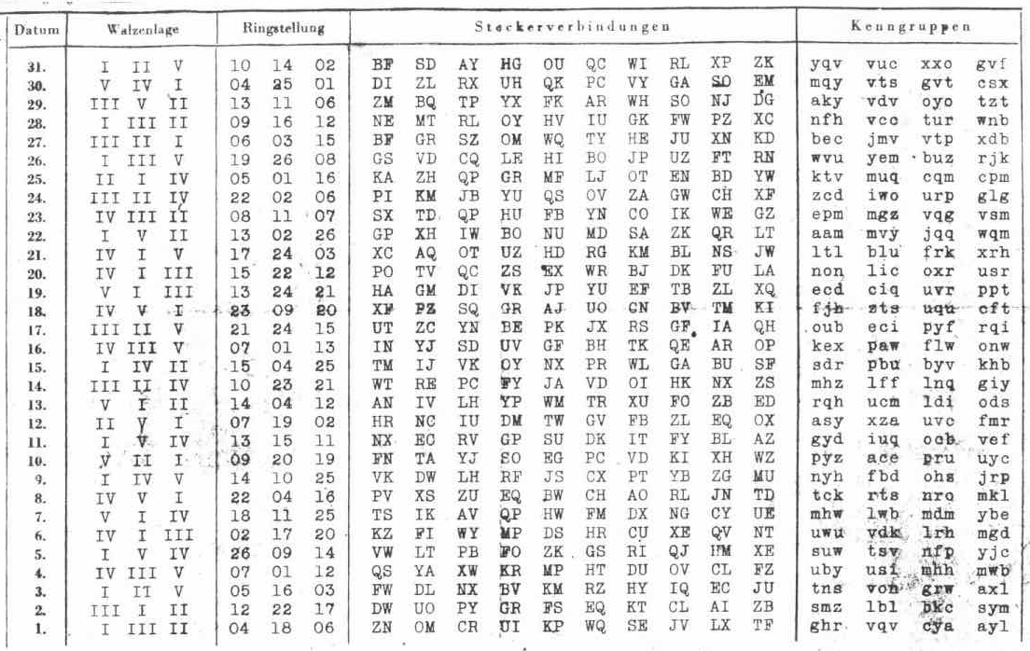
Enigma Machine
Characterized by:
UCF 07 ZERO 0800 = 50 = MHW FLC = LWB VJT LWD QYB JMS AMU RBO QXY SBZ EYN RLG RNK KVQ YJK EKR GMS CYB MH=
rotors='V I IV'
reflector='B'
ring_settings=[18, 11, 25]
Tools:
py-enigma

Slide 24
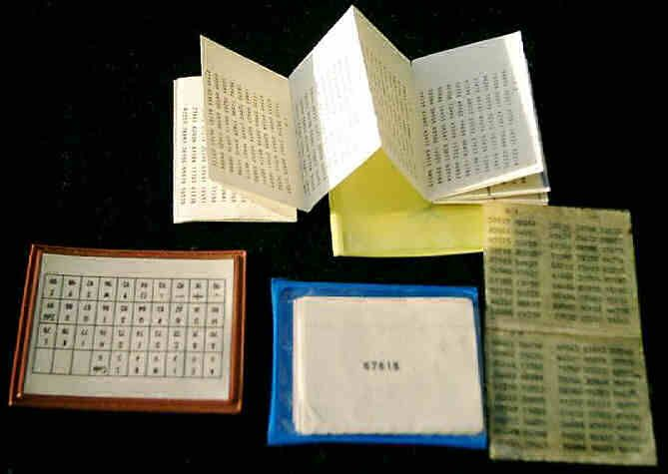
One Time Pad
Characterized by:
Repeating underlying whitespace text
Fixed size
Solved by:
Exposing hints of the underlying messages:
c_1 ^ c_2 = (m_1 ^ k) ^ (m_2 ^ k) = (m_1 ^ m_2) ^ (k ^ k) = (m_1 ^ m_2)
Frequency analysis

Slide 25
Block Cipher (AES-CBC)
Exercise: Can we manage to find the following? How?
Ciphertext
Second Ciphertext?
Plaintext
Second Ciphertext?
Initialization Vector (IV)
Key

Slide 26
Rare Challenges
themes in

Slide 27
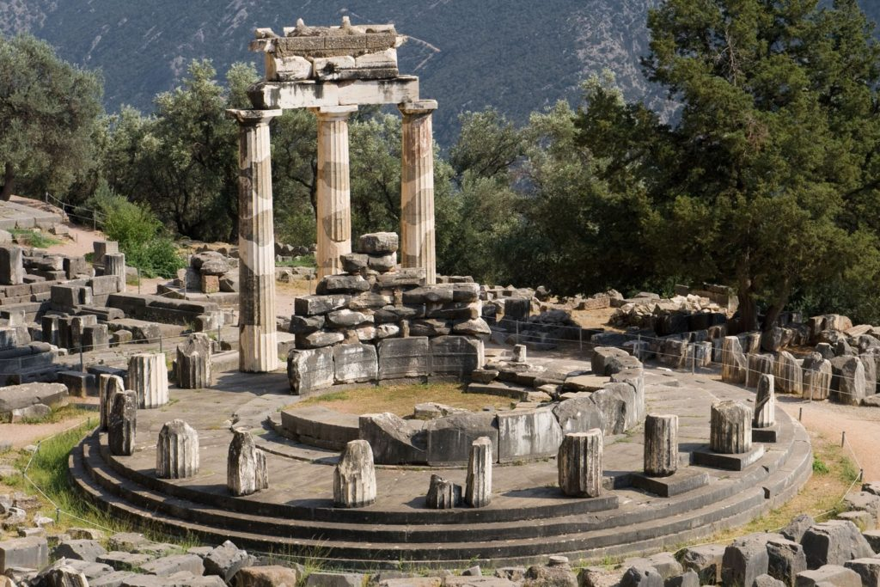
Oracle Challenges
Characterized by:
Given a server to connect to
Told to either netcat or use some fancy script to connect to it
Told to break either an encryption or authentication scheme
Typical model:
You can use the functions available (enc, dec, mac, vfy)
You cannot use these functions on the challenge text.
The key and functions directly implemented are concealed from you.
Example:
AES-CBC (from before)
CBC-MAC (from right now)

Slide 28

CBC-MAC

Slide 29
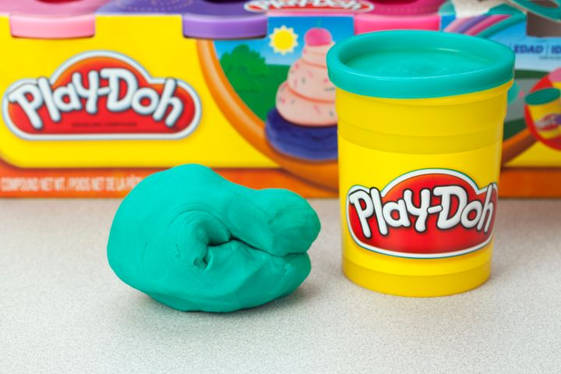
Malleability Challenges
Characterized by:
A seemingly impossible challenge
Frequently having access to an oracle or publicly available scheme
Examples:
RSA Malleability (on board)

Slide 30
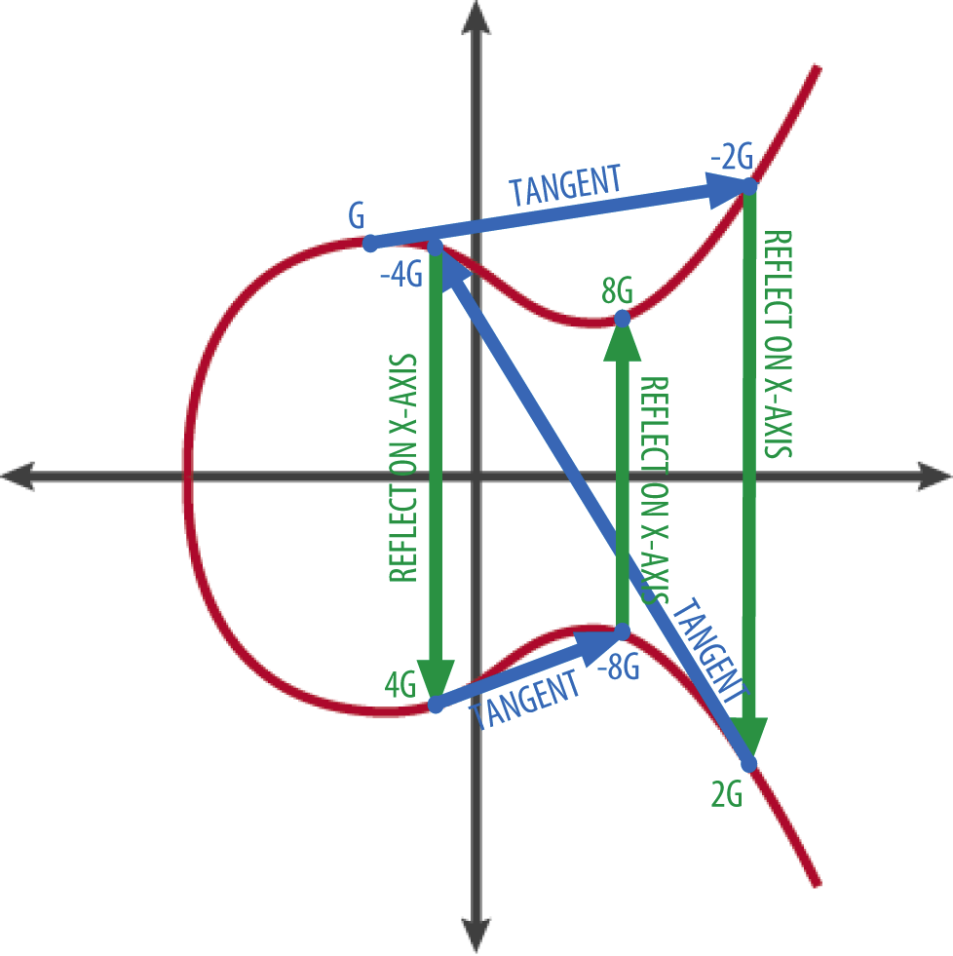
Elliptic Curve Cryptography
Characterized by:
RSA-esque
Solutions:
Unique to each implementation
Normally rooted in too simple of a curve being used
Similar to the math required in the Low-n RSA challenge
Tools:
There aren’t many fully fleshed out
Github repos
Assorted course material

Slide 31
Mythic Challenges

Slide 32
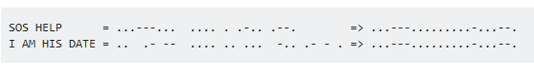
Morse Code without spaces
It’s impossible
Complain to the challenge authors
I’m looking at you lil prez - anna

Slide 33

LLL Lattice Reduction
LLL:
Lenstra
Lenstra
Lovász
General Idea:
Sometimes NP-hard problems aren’t that hard
We can break this problem into parallel
We basically become a human GPU
We can also use a normal GPU for this

Slide 34
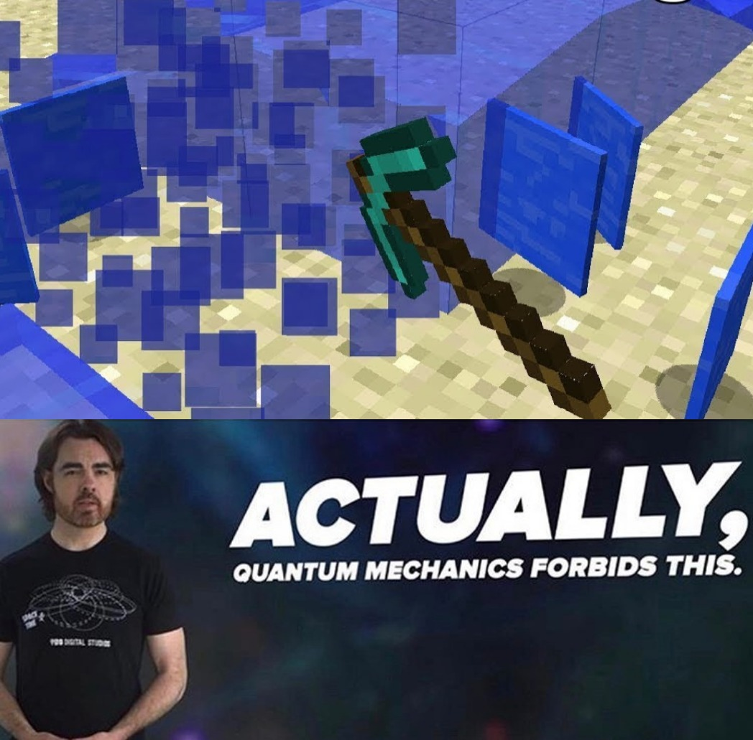

Post-Quantum Key Exchange on Blockchains
“A donut! I thought your story would be the donut hole in the donut’s hole, but now I see that there is a hole in the middle of the donut hole! Or perhaps it’s actually just a very small donut.” - Daniel Craig

Slide 35

The IOTA Problem
Reminder:
Quantum-resistant encryption does not mean pen-and-paper-resistant encryption.
Higher order functions typically mean more malleability (see: AES vs RSA).

